Slide 1


GMR Institute of Technology, Rajam
Department of CSE(Artificial Intelligence and Data Science)
WebQuery: Empowering Query-Based Data Extraction from websites
22-May-24
1
22-May-24
1

Slide 2
WebQuery: Empowering Query-Based Data Extraction from websites
1.G. Ashok Kumar(21341A4521)
2. K. Prasanthi (21341A4525)
3. A. Sai Jayanth (21341A4501)
4. P. Mohit (21341A4539)
5. CH. John Paul (21341A4516)
Under the guidance of
Mr. Nitish Kumar
Sr.Assistant Professor
GMR Institute of Technology

Slide 3
Abstract
In WebQuery revolutionizes web data extraction and query answering with its innovative web application design. The platform boasts a user-friendly interface akin to popular platforms, empowering users to input website URLs and submit queries regarding the contained data effortlessly. Leveraging advanced web scraping techniques, WebQuery swiftly and accurately extracts pertinent information from designated websites, enhancing efficiency and convenience. Its primary goal is to furnish users with an intuitive platform for extracting profound insights and valuable information from diverse web sources. Moreover, WebQuery harnesses the power of natural language processing (NLP) to interpret user queries adeptly. By analyzing the extracted data, the application generates precise and informative responses, elevating user experience and ensuring satisfaction. In addition, WebQuery integrates a sophisticated chatbot component, facilitating interactive query sessions and augmenting user engagement and usability. This strategic amalgamation of web scraping, NLP, and chatbot technologies positions WebQuery as a seamless and indispensable tool for accessing and analyzing web content. This project signifies a significant advancement in the realm of web data extraction and query answering, offering a comprehensive solution to users' information needs.

Slide 4
Introduction
In today's digital age, the extraction of data from websites has become an integral component of various industries and fields, ranging from business analytics to academic research. Traditionally, this task has been tackled through a process known as web scraping, which involves the creation of intricate scripts to navigate the complexities of website structures and retrieve desired data points. However, for many individuals without extensive programming expertise, web scraping can be daunting and inaccessible. Enter WebQuery, a groundbreaking tool that revolutionizes the landscape of web data extraction. Unlike traditional scraping methods, WebQuery employs a query-based approach, similar to the intuitive searches performed on popular search engines. This innovative technique enables users to articulate their data requirements in plain language, eliminating the need for complex coding and technical know-how. . By leveraging advanced algorithms, WebQuery interprets these queries, navigates through web page structures, and extracts the relevant data elements efficiently. This shift towards query-based extraction not only democratizes access to web data but also significantly streamlines the process, making it more accessible and user-friendly for a broader audience.

Slide 5
Introduction
Moreover, WebQuery's ability to handle dynamically generated content and complex layouts further enhances its versatility and applicability in diverse scenarios. As a result, WebQuery represents a significant leap forward in the field of web data extraction, empowering users to unlock valuable insights and information from the vast expanse of the internet with unprecedented ease and efficiency.

Slide 6
Base Paper
Keywords: Web scraping, Natural language processing (NLP), Web data extraction, User-friendly interface, amalgamation.
.
Base Paper :
Pichiyan, V., Muthulingam, S., Sathar, G., Nalajala, S., Ch, A., & Das, M. N. (2023). Web Scraping using Natural Language Processing: Exploiting Unstructured Text for Data Extraction and Analysis. Procedia Computer Science, 230, 193-202.
Objective:
Extract data from web pages efficiently and accurately.
Applications of web scrapping with nlp in the context of data extraction.
Nlp techniques such as tokenization,stemming,stop word removal.
Word2Vec, an embedding method for transforming words into dense numerical vectors, is widely utilized in the field of natural language processing (NLP)

Slide 7
Literature survey- 1
Pichiyan, V., Muthulingam, S., Sathar, G., Nalajala, S., Ch, A., & Das, M. N. (2023). Web Scraping using Natural Language Processing: Exploiting Unstructured Text for Data Extraction and Analysis. Procedia Computer Science, 230, 193-202..
This paper synthesizes existing research on web scraping techniques and their integration with Natural Language Processing (NLP) to extract and analyze unstructured textual data .
It discusses challenges and ethical considerations associated with web scraping and NLP, including honest data scraping practices, privacy concerns, and the impact of biased training data on NLP models' results .
Practical applications and use cases of web scraping using NLP across domains are highlighted, including sentiment analysis and opinion mining of online news articles, and analyzing customer feedback and reviews from online forums
The combination of web scraping and NLP methodologies provides a powerful approach to extract and analyze unstructured text, offering opportunities for data-driven decision-making processes.
Web scraping may face challenges in handling dynamic websites that frequently change their structure or employ anti-scraping measures, requiring constant updates to scraping scripts .

Slide 8
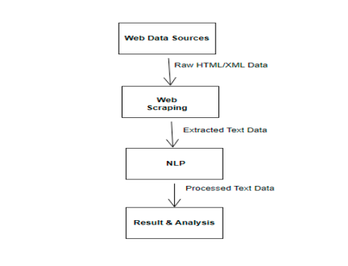
Stages of web scrapping

Slide 9
Literature survey- 2
Lunn, S., Zhu, J., & Ross, M. (2020, October). Utilizing web scraping and natural language processing to better inform pedagogical practice. In 2020 IEEE Frontiers in Education Conference (FIE) (pp. 1-9). IEEE.
Web scraping and natural language processing can be utilized to answer complex questions in computer science education.
2. Connectivism is the theoretical framework applied in this research, which emphasizes the importance of using current and accurate information for learning and decision making.
3. Web scraping allows for the extraction of large amounts of data from publicly available web pages, providing a wider array of sources for knowledge in the field.
4. Natural language processing can reliably obtain salient information from textual data, complementing qualitative analysis in educational research.

Slide 10
Literature survey- 3
Anisha, P. R., Nguyen, N. G., & Sreelatha, G. (2021, November). A Text Mining using Web Scraping for Meaningful Insights. In Journal of Physics: Conference Series (Vol.2089,No.1,p.012048).IOPPublishing.
This paper focuses on the development of a logical Text Summarization tool using Machine Learning technology and Natural Language Processing (NLP) with the help of the Natural Language Tool-Kit (NLTK) .
The tool aims to generate accurate and fluent summaries by using the Extractive approach, extracting only the main needed outline points from long texts or input documents, while avoiding repetitions .
The summarization process can be beneficial for users as it helps them quickly refer to and understand the main points of the text, especially when dealing with lengthy texts .
Efficiently extract concise and coherent summaries from long texts, helping users quickly refer to and understand the main points of the text .
Difficulty in handling unstructured and noisy data obtained through web scraping, which may require additional preprocessing steps to clean and structure the data

Slide 11
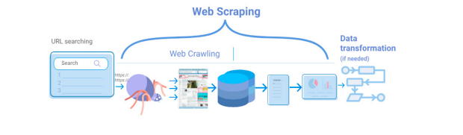
Methodology
Architecture or Flowchart
fig- 1: Exisiting Architecture

Slide 12
Methodology
Existing Algorithm:
This Algorithm of Web scraping V5
Web scraping V5.Algorithm (request, response, soup):
Step.1: Type URL Address for web scraping URL=Type URL address
Step.2: Send an HTTP request to the URL response = requests.get(url)
Step.3: Check if the request was successful if response.status code == 200: Parse the HTML content of the page soup Beautiful Soup(response.text, ’html.parser’)
Step.4: Extract information from the parsed HTML
Stpe.5: find all the links on the page links = soup.find all(’a’)
Step.6: Print the links
Step.7: for link in links: print(link.get(’href’)) else: If the request was not successful, print an error message
print(”Error:”, response.status code)
End

Slide 13
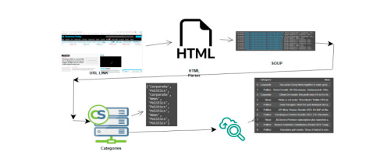
Methodology
fig - 2: extract dataset from the url

Slide 14
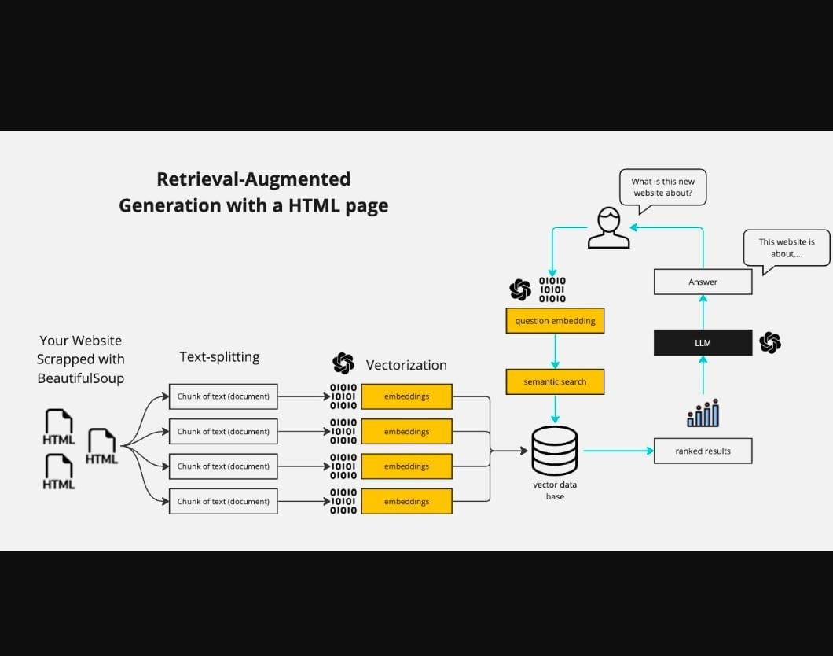
Methodology
Architecture or Flowchart
fig- 2: proposed Architecture

Slide 15
Methodology
Proposed Algorithm:
Initialization: Set up the environment and session state variables.
Web Scraping: Extract and clean text from the provided website URL.
Text Processing: Split the cleaned text into individual sentences.
Vectorization: Convert sentences into TF-IDF vectors for similarity calculations.
Database Storage: Store vectors and sentences in a SQLite database.
Keyword Matching: Find sentences containing the user's query.
Semantic Search: Find the most semantically similar sentence to the user's query.
Summarization: Summarize the response using a fine-tuned BART model.
Streamlit Interface: Handle user interactions and display the chat history.
Language Model Response: Generate a response using GPT-2.

Slide 16
Methodology
Proposed Algorithm:
Initialization and Web Scraping:
The user enters the website URL: https://example.com.
The scrape_website function is called, which fetches the content from the URL and extracts the text from <p> tags.
Example Output: "Welcome to Example.com. We offer a variety of products and services. Our mission is to provide quality and satisfaction. Contact us for more details."
The split_text function then splits this text into sentences.
Example Sentences: Sentences:
1. "Welcome to Example.com."
2. "We offer a variety of products and services."
3. "Our mission is to provide quality and satisfaction."
4. "Contact us for more details."

Slide 17
Methodology
Proposed Algorithm:
2. Vectorization:
The vectorize_data function converts these sentences into TF-IDF vectors.
Example TF-IDF Vectors:TF-IDF Vectors:
[Vector for Sentence 1, Vector for Sentence 2, Vector for Sentence 3, Vector for Sentence 4]
The split_text function then splits this text into sentences.
Example Sentences: Sentences:
1. "Welcome to Example.com."
2. "We offer a variety of products and services."
3. "Our mission is to provide quality and satisfaction."
4. "Contact us for more details."
3. Database Storage:
The store_vectors_in_database function stores these vectors in a SQLite database.

Slide 18
Methodology
Proposed Algorithm:
4. User Query:
The user enters a query: "What products do you offer?"
5. Keyword Matching:
The keyword_matching function searches for the query within the sentences
Example Matching Sentences:
Matching Sentences:
1. "We offer a variety of products and services."
6. Semantic Search:
The semantic_search function calculates the cosine similarity between the query vector and the stored vectors.
Similarities:
[0.1, 0.9, 0.3, 0.2]
The sentence with the highest similarity: "We offer a variety of products and services."

Slide 19
Methodology
Proposed Algorithm:
7. Language Model Response:
The use_llm function uses GPT-2 to generate a response based on the most similar sentence
GPT-2 Response:
"At Example.com, we offer a wide range of products including electronics, clothing, and home appliances. Our services include free shipping and 24/7 customer support."
8. Summarization:
The give_answer function uses a fine-tuned BART model to summarize the response.
Example BART Summary:
BART Summary:
"Example.com offers electronics, clothing, and home appliances with free shipping and 24/7 support."
9. Chat History Display:
The interaction is appended to the chat history and displayed.
Example Chat History:

Slide 20
Methodology
Proposed Algorithm:
Human: What products do you offer?
AI: Example.com offers electronics, clothing, and home appliances with free shipping and 24/7 support.
Analysis:
Web Scraping and Text Processing:
Successfully extracted and cleaned text from the website.
Efficiently split text into sentences for further processing.
Vectorization and Storage:
TF-IDF vectorization provided a robust representation of the sentences.
Storing vectors in a database allowed for quick retrieval and similarity calculations.
Keyword Matching:
Simple yet effective in identifying sentences containing the query keywords.
Useful for direct keyword-based searches.

Slide 21
Methodology
Proposed Algorithm:
Semantic Search:
Provided a more nuanced understanding of the query by comparing semantic similarities.
Enhanced the ability to find the most relevant sentence based on context.
Language Model Response:
GPT-2 generated coherent and contextually appropriate responses based on the retrieved sentence.
Enhanced user interaction by providing detailed answers.
BART effectively summarized the response, making it concise and easier to read.
Ensured that the user received clear and relevant information.
User Experience:
The application provided an interactive and informative experience.
Chat history maintained a record of interactions, enhancing continuity in the conversation.

Slide 22
Methodology
Proposed Algorithm:
Summarization:
BART effectively summarized the response, making it concise and easier to read.
Ensured that the user received clear and relevant information.
User Experience:
The application provided an interactive and informative experience.
Chat history maintained a record of interactions, enhancing continuity in the conversation.

Slide 23
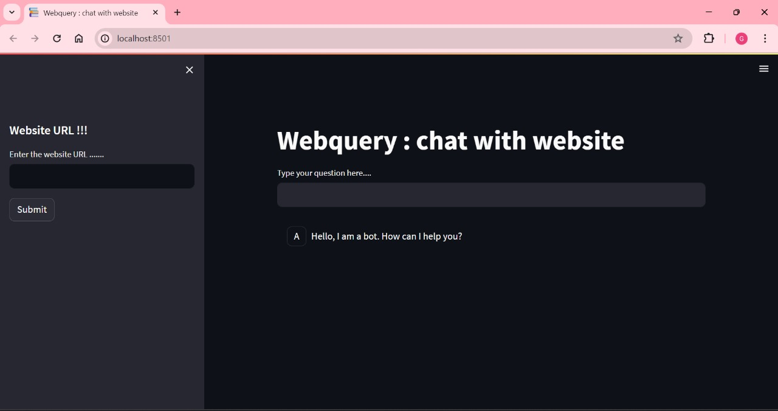
Results & Analysis

Slide 24
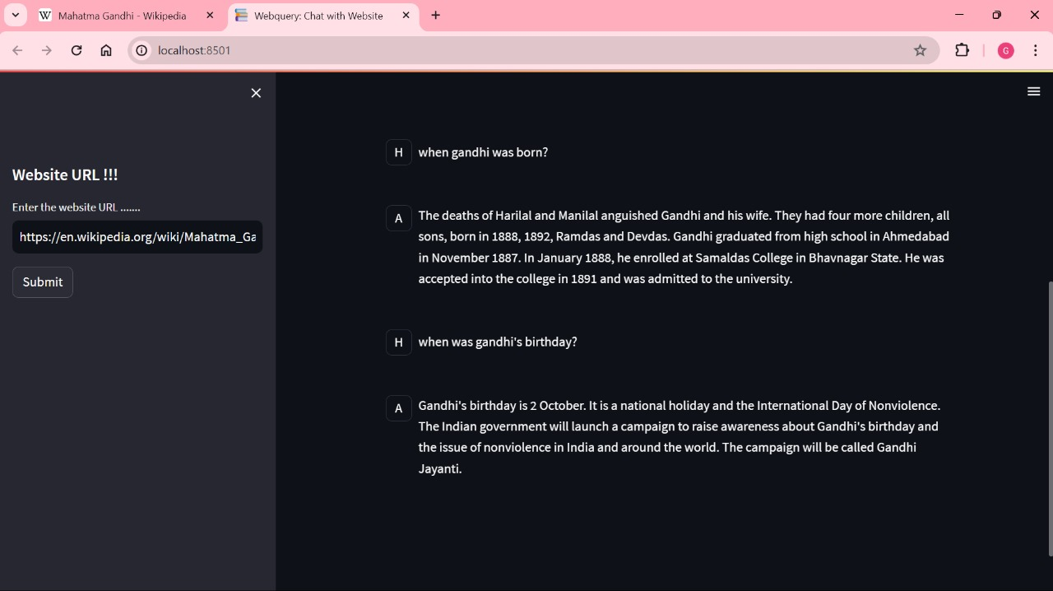
Results & Analysis

Slide 25
Conclusion
The implementation of the Webquery chatbot successfully demonstrates the integration of various natural language processing and machine learning techniques to create an interactive and informative user experience. By combining web scraping, text processing, TF-IDF vectorization, keyword matching, semantic search, and language model response generation, the application efficiently addresses user queries based on the content of a provided website.

Slide 26


